Slide 1

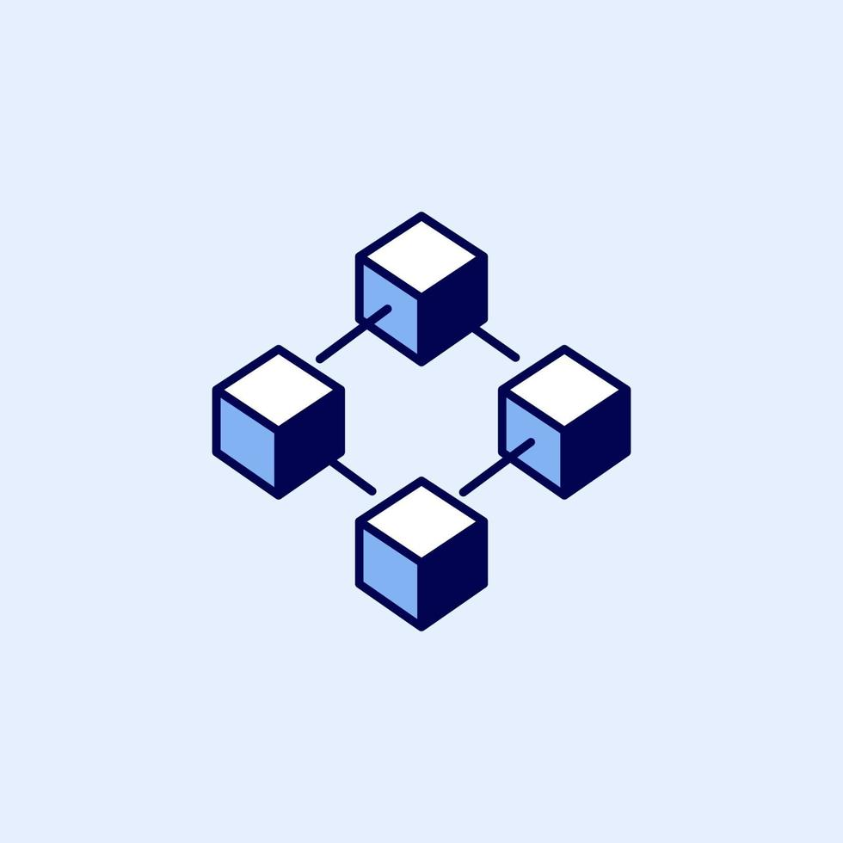
Shri Ramdeobaba College of Engineering and Management
DEPARTMENT OF COMPUTER SCIENCE AND ENGINEERING
SESSION 2023-2024
GENUINE AND TRANSPARENT BLOCKCHAIN BASED CHARITY APPLICATION
Industry Mentor
Sugam Bhatnagar
Guide
Dr. Abhijeet R. Raipurkar

Slide 2
Table of
Contents
Page
I
Problem Statement
3
II
Introduction
4
III
Objectives
5
IV
Tech Stack
6
V
Module Completed
7
VI
Drawbacks
13
Proposed Solutions
14
VII
VIII
Hpyerledger Fabric
15
IX
Rewarding System using NFT
16

Slide 3
Problem Definition
Non-profit organizations raise charity donations through different sources, and the funds they raise often require clean traceability. Recently, fake charity fundraising schemes have raised social concern, and a trusted and auditable approach is necessary to manage charity organizations' reputations. The charity organizations lack transparency, and their supervision is difficult to achieve, which has a negative impact on the willingness of the people to donate. Students are required to design blockchain-based charity (BBC) systems that are decentralized and guarantee trust, transparency, and chronology between donors and beneficiaries.
Notes:
"Good afternoon everyone,Myself Prasanna Tapkire and this is my team:Pushkar Pophali,Isha Mankar and Aashia Sorathia and today we are here to discuss and give presentation on our project topic "Blockchain based genuine and transparent charity application. As you all know, transparency and accountability are essential components of any successful charity. Donors want to ensure that their contributions are making a real impact, and charities need to be able to demonstrate that their funds are being used effectively. This is where blockchain technology comes in. By leveraging the power of a decentralized, transparent ledger system, we can create a new generation of charity application that ensure genuine, transparent, and accountable charity. In this seminar, we'll explore the potential of blockchain-based charity applications and discuss the benefits they offer.

Slide 4
Introduction
Why are we implementing this technology:
Problems in Charity Application:
Lack of transparency:
High transaction fees
Inefficient record keeping
Fraud and misuse of funds
Proposed solutions which will be implemented by our software/application:
Increased Transparency
Enhanced security
Less fraud cases due to decentralized system
Efficient record-keeping
Increased donor Engagement
Notes:
"Good afternoon everyone,Myself Prasanna Tapkire and this is my team:Pushkar Pophali,Isha Mankar and Aashia Sorathia and today we are here to discuss and give presentation on our project topic "Blockchain based genuine and transparent charity application. As you all know, transparency and accountability are essential components of any successful charity. Donors want to ensure that their contributions are making a real impact, and charities need to be able to demonstrate that their funds are being used effectively. This is where blockchain technology comes in. By leveraging the power of a decentralized, transparent ledger system, we can create a new generation of charity application that ensure genuine, transparent, and accountable charity. In this seminar, we'll explore the potential of blockchain-based charity applications and discuss the benefits they offer.

Slide 5
Objectives
The objective is to propose Blockchain based decentralized donation tracking system built on Ethereum blockchain for nonprofit organization raise charity donation through different sources, and raised funds often require clean traceability.
To run project transparently, using smart contract-based incentives to ensure their impact Is independently verified and accessible to everyone.
Notes:
"Good afternoon everyone,Myself Prasanna Tapkire and this is my team:Pushkar Pophali,Isha Mankar and Aashia Sorathia and today we are here to discuss and give presentation on our project topic "Blockchain based genuine and transparent charity application. As you all know, transparency and accountability are essential components of any successful charity. Donors want to ensure that their contributions are making a real impact, and charities need to be able to demonstrate that their funds are being used effectively. This is where blockchain technology comes in. By leveraging the power of a decentralized, transparent ledger system, we can create a new generation of charity application that ensure genuine, transparent, and accountable charity. In this seminar, we'll explore the potential of blockchain-based charity applications and discuss the benefits they offer.

Slide 6


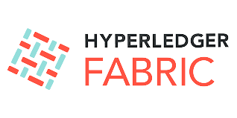

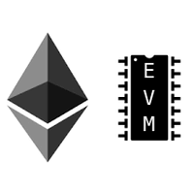




Tech Stack
Smart Contracts
Hyperledger
Fabric
React
Ethers.js
mongo DB
EVM
Express JS
IPFS
Tailwind css

Slide 7
MODULES COMPLETED

Slide 8
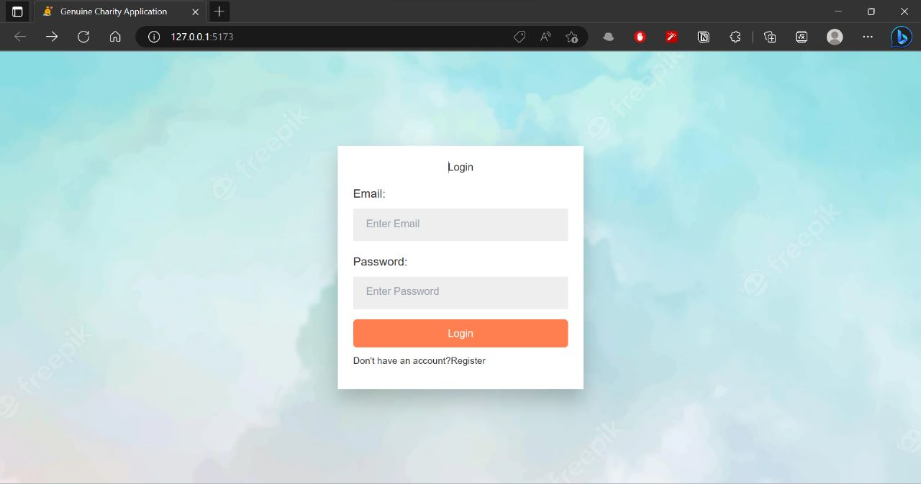

Slide 9
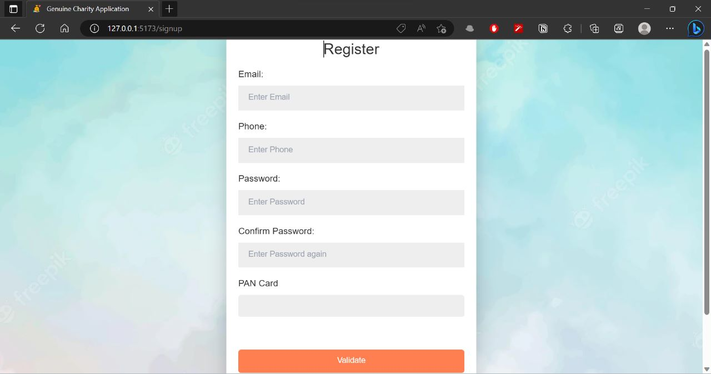

Slide 10
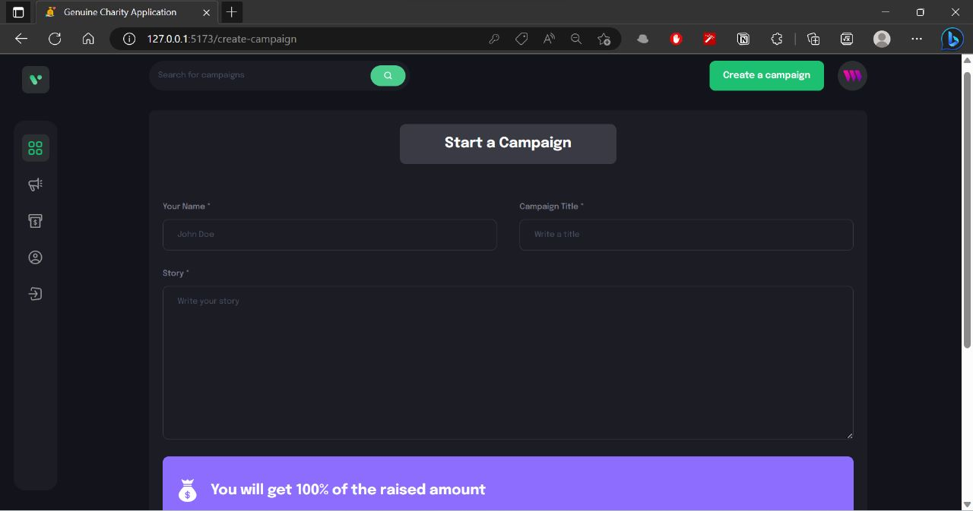

Slide 11
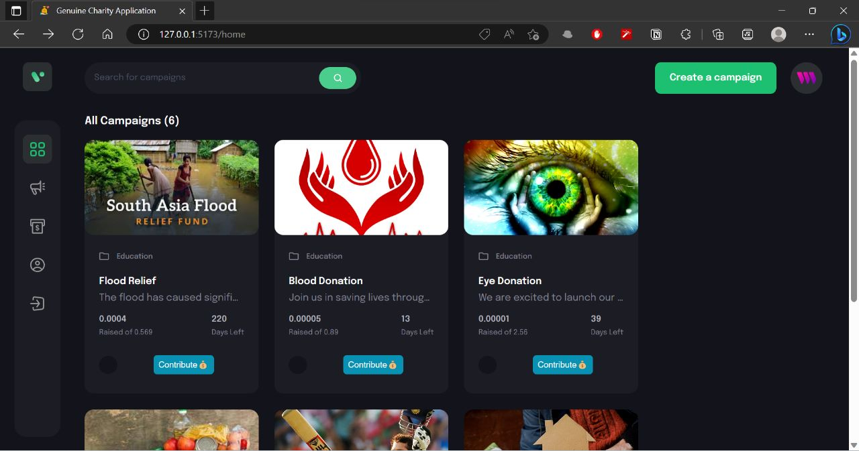

Slide 12
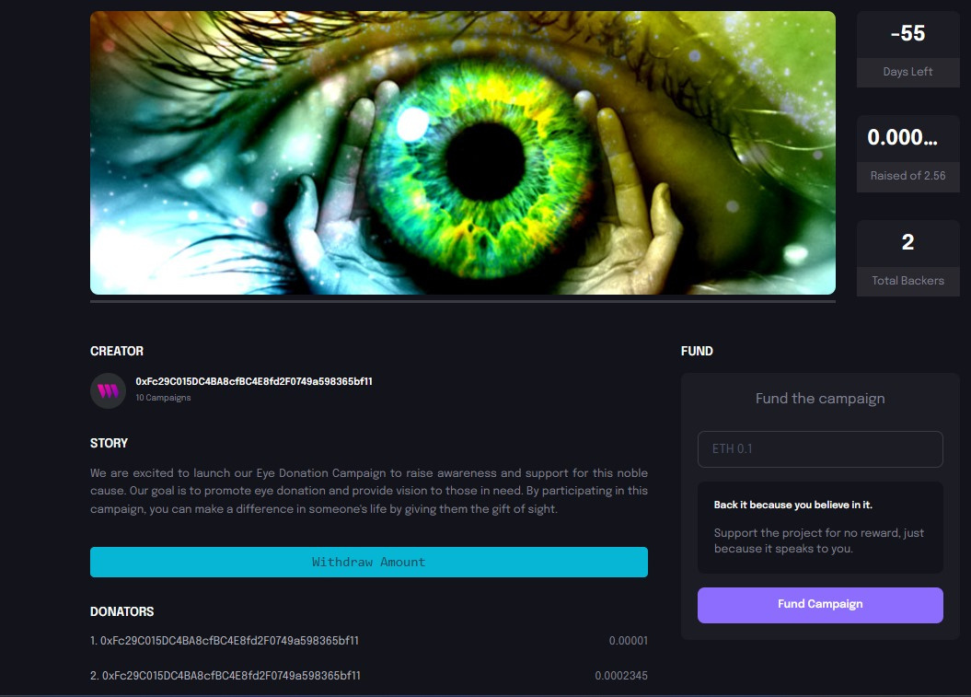

Slide 13

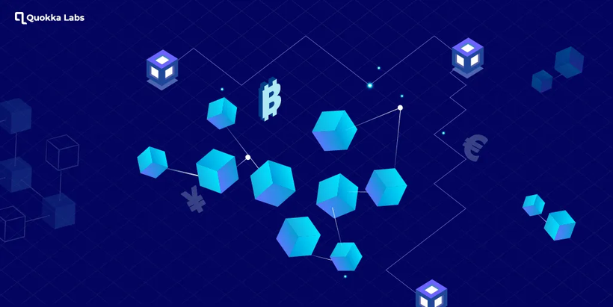
Drawbacks we intend to overcome...
Data Privacy and Confidentiality
Sensitive Data Exposure
Varying Network Requirements
Use of only a Single Consensus Mechanism
Incentive and Customer Engagement
Notes:
"Good afternoon everyone,Myself Prasanna Tapkire and this is my team:Pushkar Pophali,Isha Mankar and Aashia Sorathia and today we are here to discuss and give presentation on our project topic "Blockchain based genuine and transparent charity application. As you all know, transparency and accountability are essential components of any successful charity. Donors want to ensure that their contributions are making a real impact, and charities need to be able to demonstrate that their funds are being used effectively. This is where blockchain technology comes in. By leveraging the power of a decentralized, transparent ledger system, we can create a new generation of charity application that ensure genuine, transparent, and accountable charity. In this seminar, we'll explore the potential of blockchain-based charity applications and discuss the benefits they offer.

Slide 14

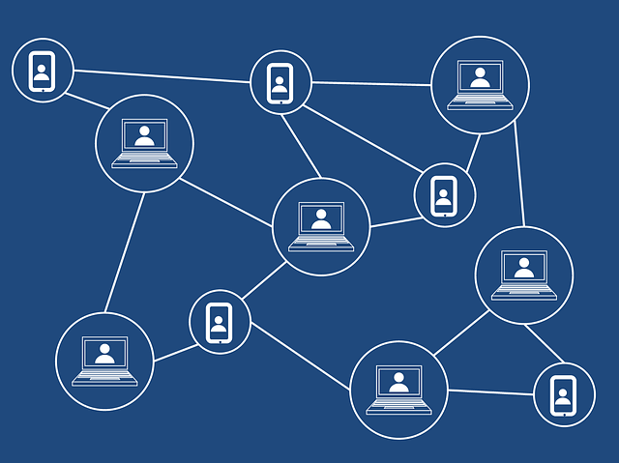
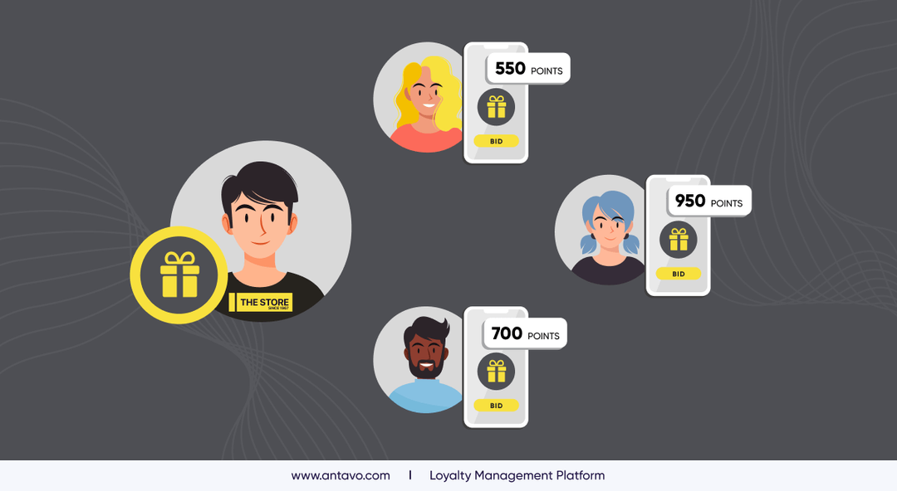
Proposed Solutions
Private Network Setup
Transparency through Auditing
Data Privacy and Encryption
Flexible Consensus Mechanism
Rewarding System using NFT
Notes:
"Good afternoon everyone,Myself Prasanna Tapkire and this is my team:Pushkar Pophali,Isha Mankar and Aashia Sorathia and today we are here to discuss and give presentation on our project topic "Blockchain based genuine and transparent charity application. As you all know, transparency and accountability are essential components of any successful charity. Donors want to ensure that their contributions are making a real impact, and charities need to be able to demonstrate that their funds are being used effectively. This is where blockchain technology comes in. By leveraging the power of a decentralized, transparent ledger system, we can create a new generation of charity application that ensure genuine, transparent, and accountable charity. In this seminar, we'll explore the potential of blockchain-based charity applications and discuss the benefits they offer.

Slide 15
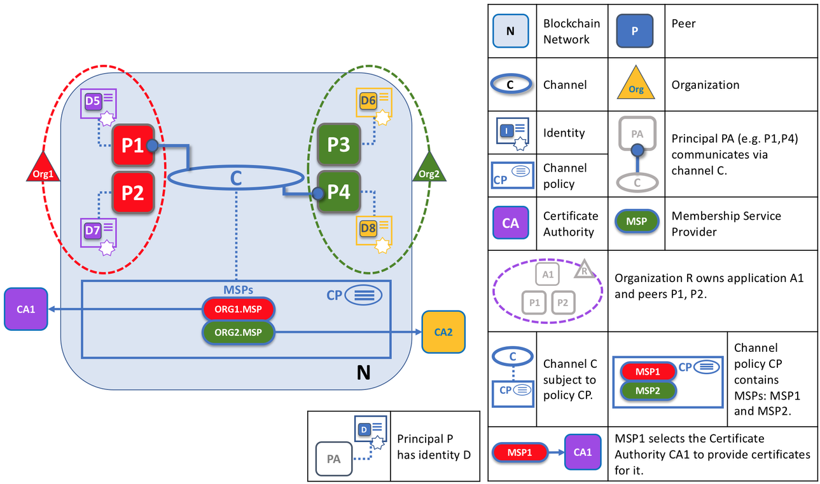
Hpyerledger Fabric
Enterprise-grade, Distributed ledger platform
Highly modular
Permissioned architecture
Multi-language smart contract support: Go, Java, Javascript
Pluggable consensus
Notes:
"Good afternoon everyone,Myself Prasanna Tapkire and this is my team:Pushkar Pophali,Isha Mankar and Aashia Sorathia and today we are here to discuss and give presentation on our project topic "Blockchain based genuine and transparent charity application. As you all know, transparency and accountability are essential components of any successful charity. Donors want to ensure that their contributions are making a real impact, and charities need to be able to demonstrate that their funds are being used effectively. This is where blockchain technology comes in. By leveraging the power of a decentralized, transparent ledger system, we can create a new generation of charity application that ensure genuine, transparent, and accountable charity. In this seminar, we'll explore the potential of blockchain-based charity applications and discuss the benefits they offer.

Slide 16
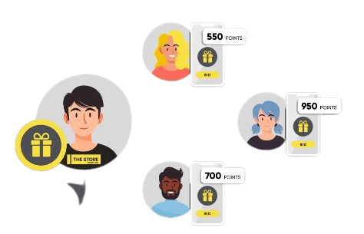
What is NFT?
NFT stands for Non-Fungible Token.
It's a type of digital asset that represents ownership or proof of authenticity of a unique item or piece of content using blockchain technology.
Notes:
so first let's talk about the Problems in traditional charity oraganizations:
1. Lack of transparency: most of the times the financial records of the charity organizations are not public and hence the donor is unaware of the way his donations are being used
2. Inefficient record-keeping: it is not possible to maintain each and every transaction record in a structured format by traditional ways
3. Fraud and misuse of funds:The funds can be misused in malicious activities such as money laundering,corruption etc.
To further continue with the topic i would like to call Isha

Slide 17
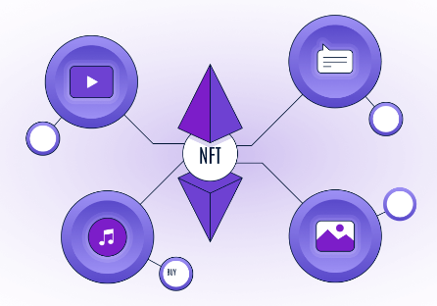
Rewarding System using NFT
Why NFT?
How donors can use the rewarded NFTs ?
How will the NFTs be managed?
How will we implement NFT?

Slide 18
Computer Science and Engineering, RCOEM
GUIDE
PARTICIPANTS
Dr. Abhijeet R. Raipurkar
Prasanna Tapkire
Pushkar Pophali
Isha Mankar
Aashia Sorathia
Industry Mentor
Sugam Bhatnagar Sir
Thank you
for listening!

